Slide 1
GLOBE
2019 GLOBE Asia-Pacific Regional Meeting
2018 Taiwan Report
Venue: Seoul, Republic of Korea
Taiwan Coordinator: Pay-Liam Lin

Slide 2
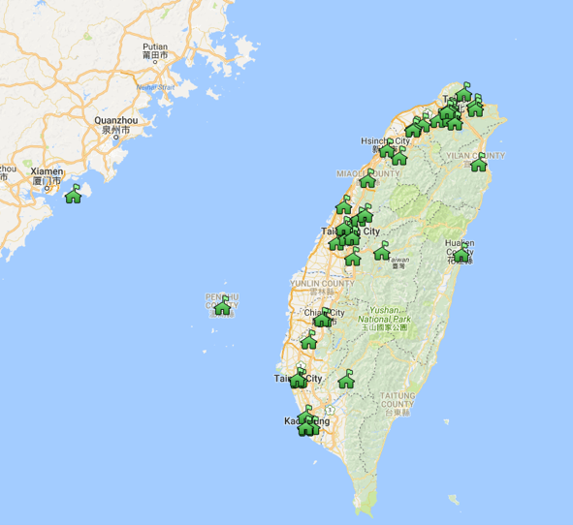
Current Status
51
GLOBE schools
139
GLOBE teachers
3114
GLOBE students
294955
Data entries
11
Workshop held
144
People trained

Slide 3
Protocols currently used in Taiwan
Digital Multi-Day Max-Min-Current Air
Soil Temperature
Barometric Pressure
Clouds Observations
Precipitation
Relative Humidity
Surface Temperature
Davis Weather Station
Aerosols
Water Temperature
Water pH
Transparencies
Alkalinities
Conductivities
Nitrates
Salinities
Dissolved Oxygens
GPS

Slide 4
2018 GLOBE Taiwan Events
GLOBE Taiwan students participated GLOBE IVSS
Taiwan students were invited to attend the webinar of GLOBE ENSO Field Measurement Campaign
AIT officers visited GLOBE Taiwan Team and one of GLOBE school
Taiwan team participated in 2018 GLOBE Annual Meeting & GLE
2018 GLOBE Taiwan Science Festival
Taiwan team participated in GLOBE Thailand Students Exchange Program
Taiwan team participated in GLE in Nepal
GLOBE Taiwan Train-the-Teacher Workshop

Slide 5
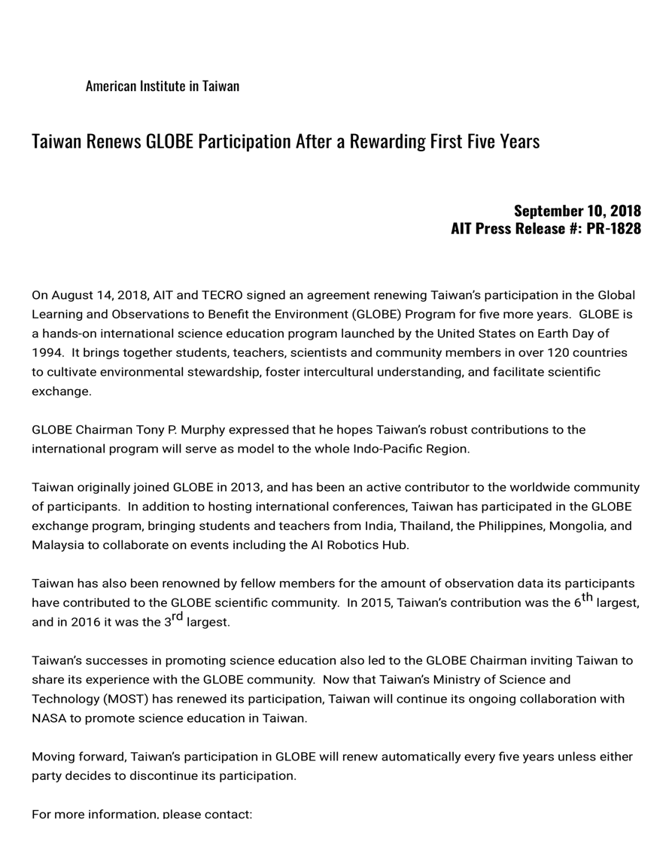
The Taipei Economic and Cultural Representative Office (TECRO) and its counterpart establishment the American Institute in Taiwan (AIT) renewed the agreement on Aug. 14 for Taiwan’s participation in the Global Learning and Observations to Benefit the Environment (GLOBE) Program.
Simple Portfolio Presentation

Slide 6
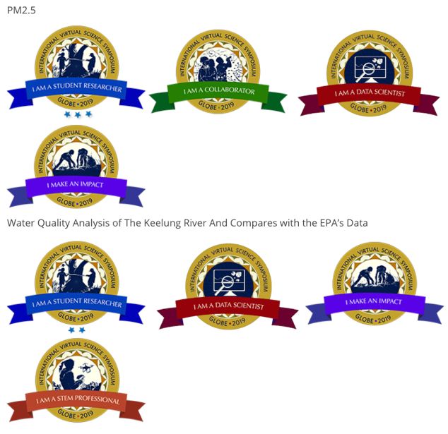
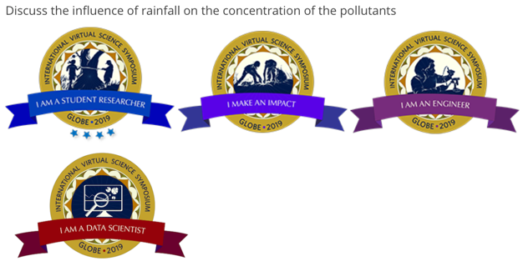
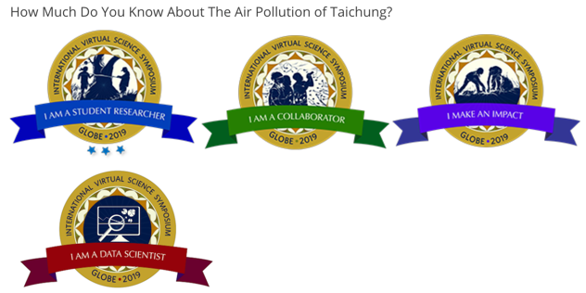
2019 GLOBE IVSS
AnLe Senior High School
KaoHsiung Girls’ Senior High School
DanFeng Senior High School
ZhongZheng Senior High School
LoTung Senior High School

Slide 7
2018/04/12 GLOBE ENSO Field Measurement Campaign
Houjia junior high school was invited by Dorian Janney to share their daily observations and results at the webinar of GLOBE ENSO Field Measurement Campaign.

Slide 8
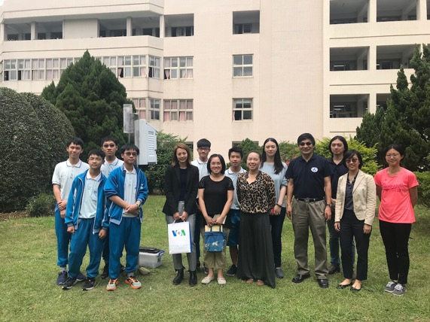
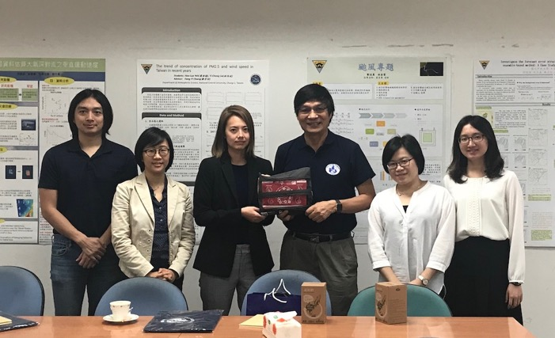
2018/04/19 Visiting of AIT
Two Officers of AIT(American Institute in Taiwan) visited GLOBE Taiwan Office and one of GLOBE school, Fudan High school.

Slide 9
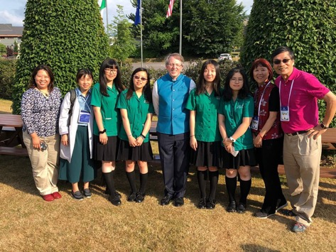
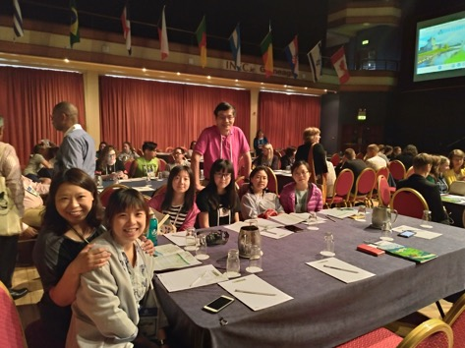
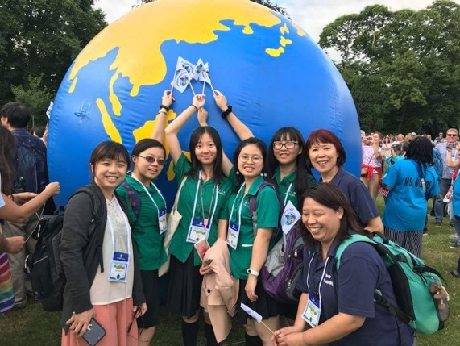
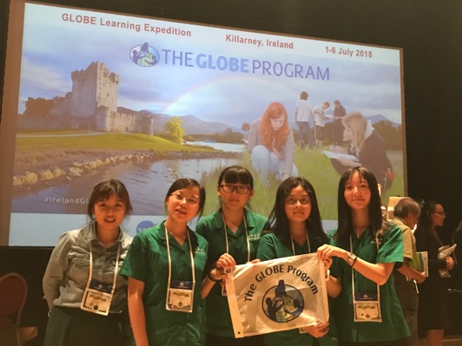
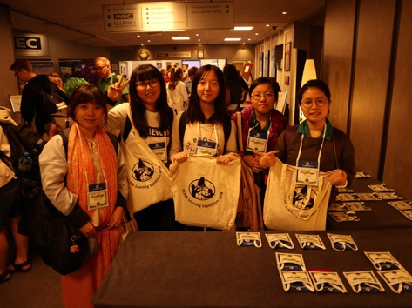
2018 GLOBE Annual Meeting & GLE
We sent the team from Taichung Girls’ Senior High school, who earned 4-star research badge in 2018 GLOBE IVSS, to participated in 2018 GLE in Ireland.

Slide 10
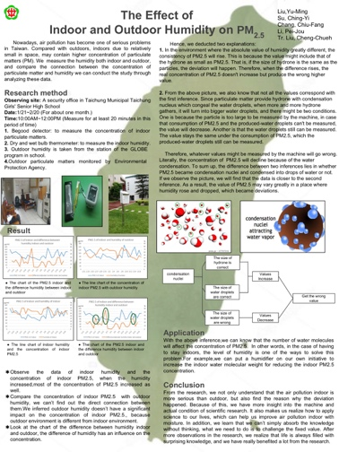
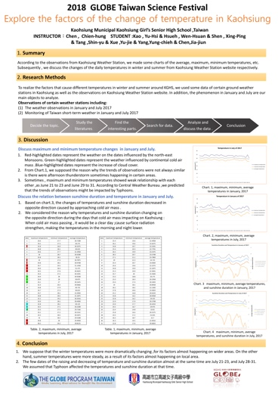
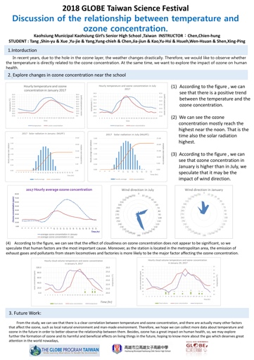
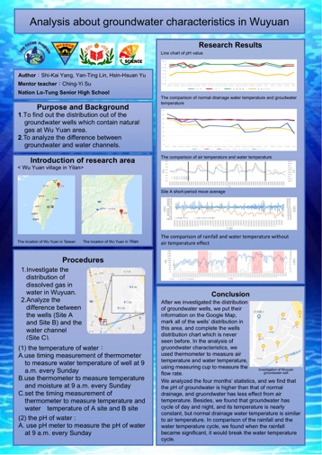
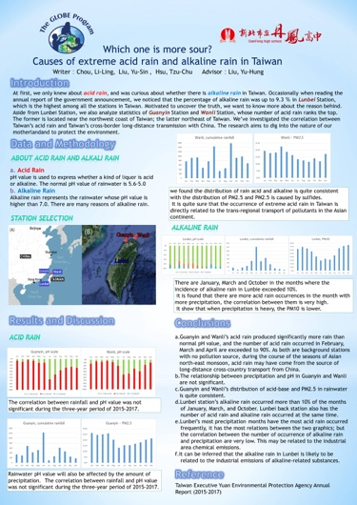
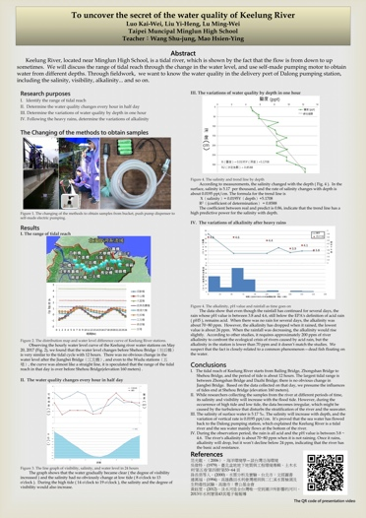
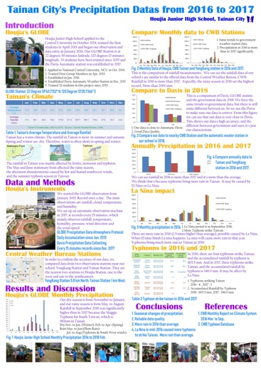
2018 GLOBE Taiwan Science Festival
7 Taiwan students’ reports

Slide 11
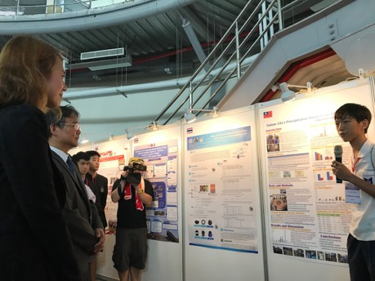
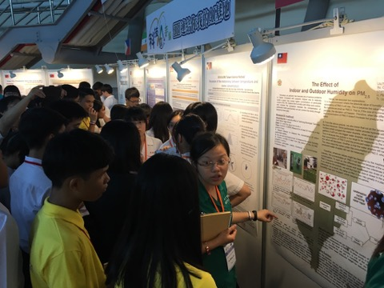
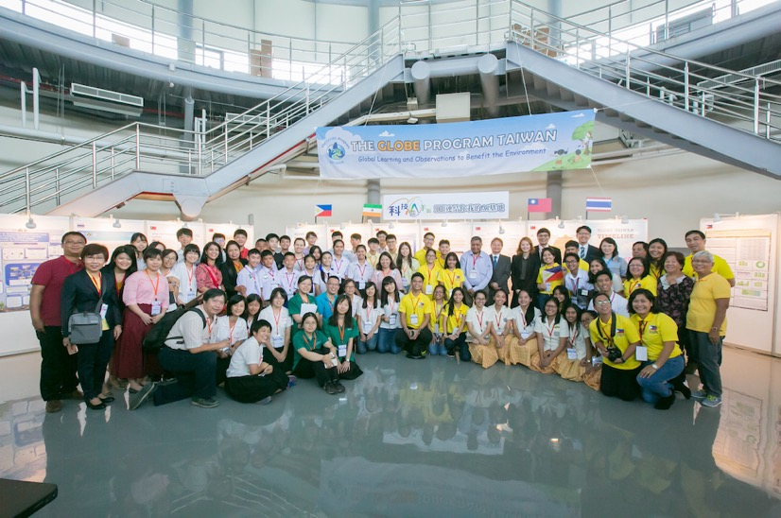
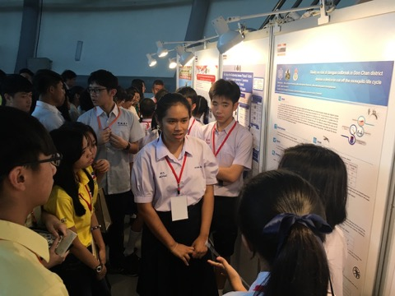
2018 GLOBE Taiwan Science Festival
We hosted 2018 GLOBE Taiwan Science Festival on July 19-23. There were 82 GLOBE participants from India, Philippines, Thailand and Taiwan.

Slide 12
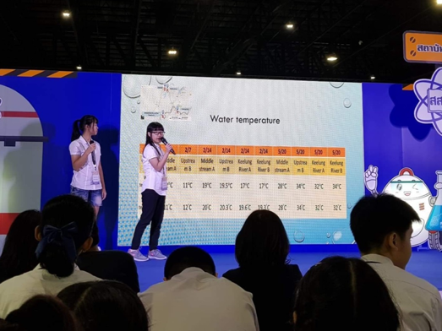
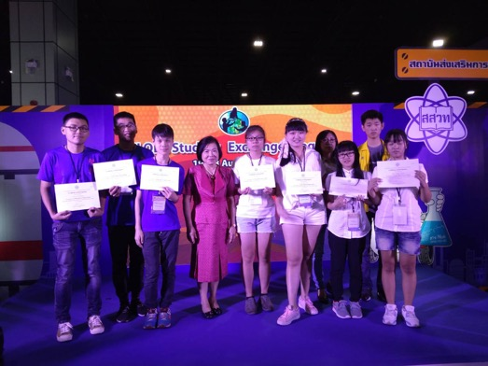
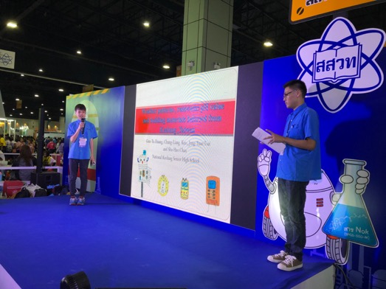
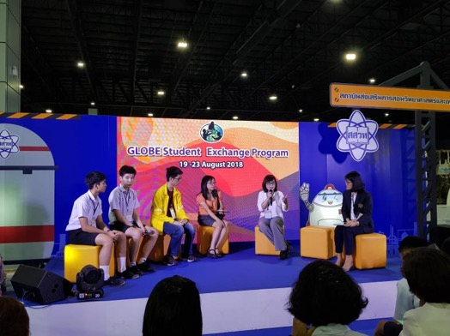
2018 GLOBE Thailand Students Exchange Program
3 Taiwan teams participated in GLOBE Thailand Students Exchange Program

Slide 13
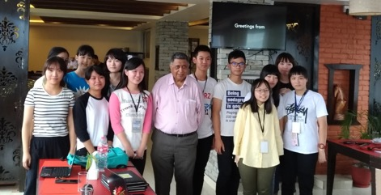
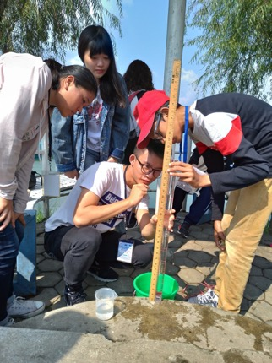
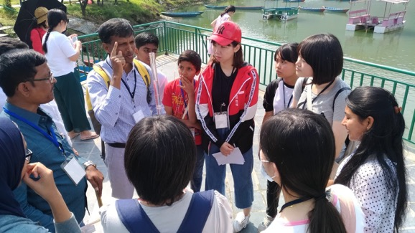
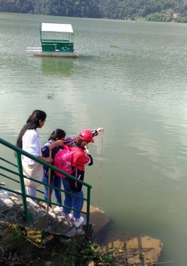
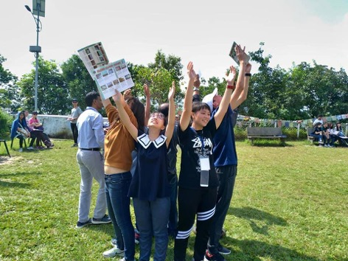
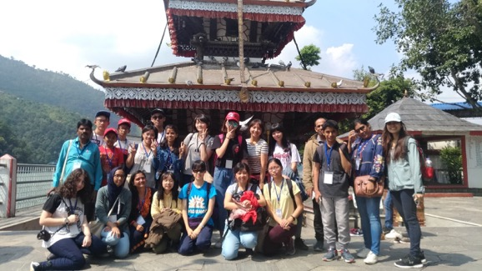
2018 GLOBE Nepal Expedition
3 teachers and 12 students participated in

Slide 14
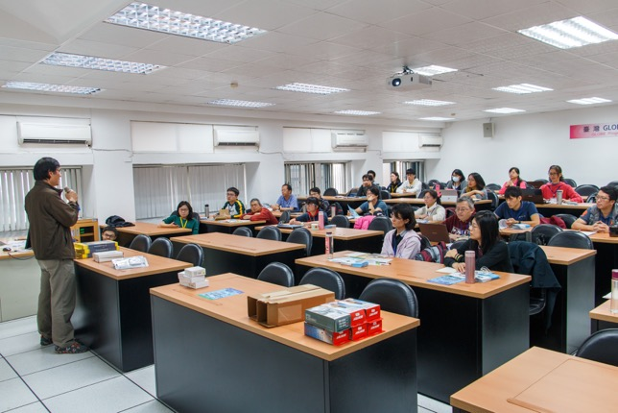
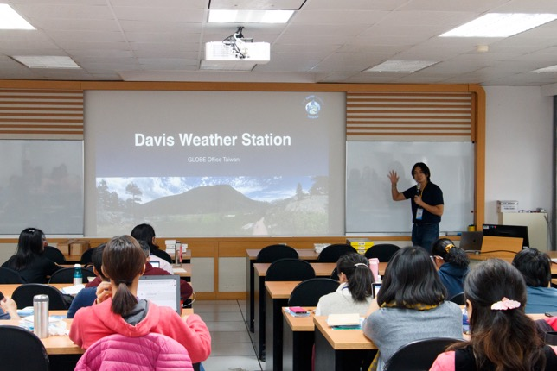
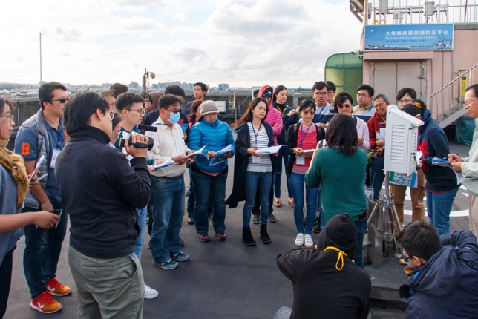
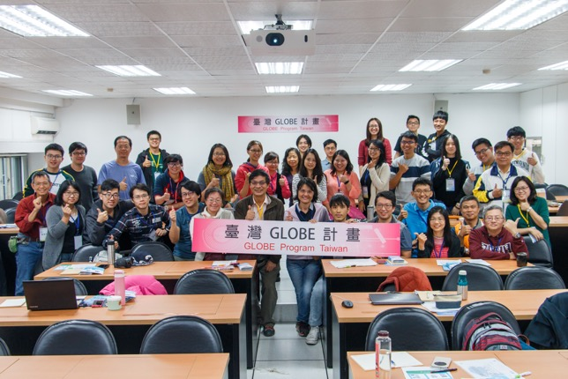
2018/12/08 GLOBE Train-the-Teacher Workshop

Slide 15
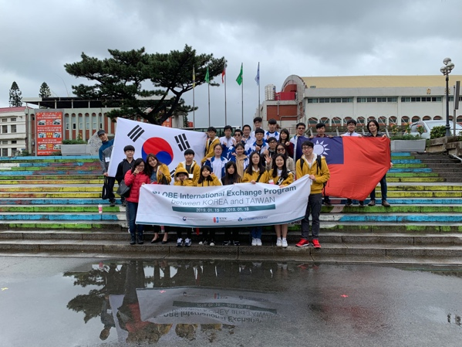
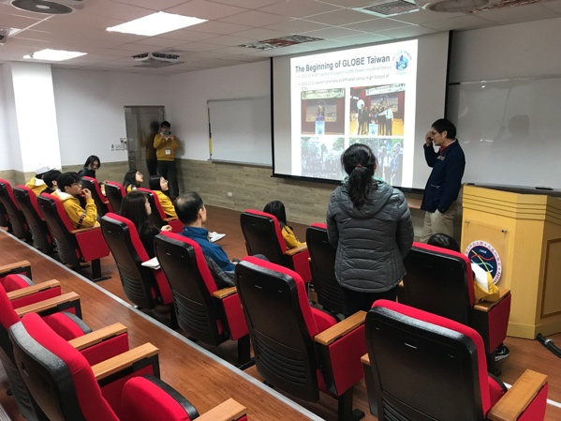
2019/01/15-18 Visiting of GLOBE Korea (KOFAC)
GLOBE Korea, Bo kyung Park, 2 teachers, and 9 students visited GLOBE Taiwan and one of GLOBE school, The Affiliated Jhongli Senior High School of NCU.

Slide 16
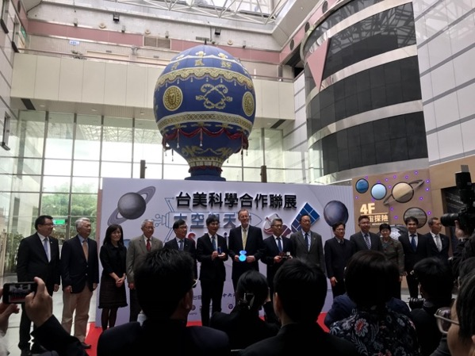
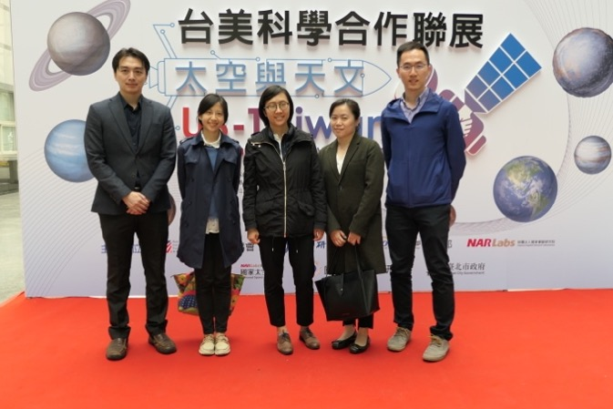
2019/02/26 US-Taiwan Space and Astronomy Exhibition – Opening Ceremony
GLOBE Taiwan Office was invited by AIT to attend “US-Taiwan Space and Astronomy Exhibition.” The theme of this event was the US-Taiwan cooperation on research and development in the field of space and astronomy.

Slide 17
2019
PLANS

Slide 18
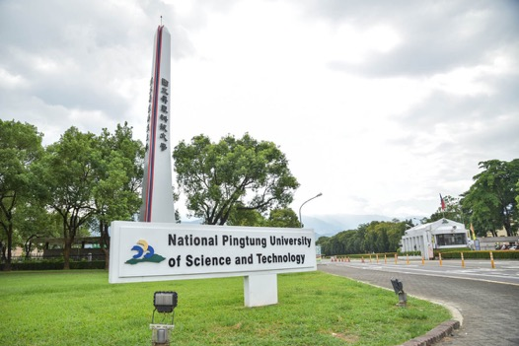
2019 PLANS
May-July
September or December
financing for GLOBE Taiwan Program
We plan to host GLOBE activity for celebrating 40 years of friendship and partnership between US and Taiwan.
GLOBE Taiwan Science Festival at Pintung, Taiwan
July 10-12

Slide 19
G
TAIWAN
L
O
Thank You
B
E

